Slide 1

2026 Catalogue of Stock Birds
Welcome to Group 1 Lofts & hope you enjoy looking at our birds.

Slide 2
Major Wins in the last decade
In the last 10 years our birds have amassed some incredible results, whilst we have scored over 400 top 30 SAHPA prizes, we have also gained over 50 top One Loft Race prizes in both Australia and on the international stage.

Slide 3
1st SAHPA LDC Alice Springs 1300 km 2023
1st SAHPA Glendambo YBC (Young Bird Championship) 2212 b 2022
1st SAHPA Lyndhurst Open 2050 birds 2017
1st SAHPA Pimba 412 km 2873 birds 2023
1st SAHPA Marla Open 1962 birds 2016 (only bird in SAHPA on day)
1st SAHPA Open Stirling North 2475 birds 2015
1st SAHPA LDC Coober Pedy Cock Special 2021 (racing with G Hamilton)
1st Bill Walford $10000 Lyndhurst YBC 2016
1st Gold Coast 50000 Race 1 Ballina 115 km 2022
1st Gold Coast 50000 Race 1 Harwood Island 175 km 2019
1st SAHPA Champion Bird of the Year 2020 (racing with G Hamilton)
1st SAHPA Vin Blanden Memorial 2020 (racing with G Hamilton)
1st SAHPA Overall Long Distance Champion 2023
1st SAHPA Overall Champion Bird of the Year 2024
1st SAHPA Ace Young Bird of the Year 2024
2nd SAHPA Overall Long Distance Championship 2024
3rd SAHPA Overall Short Distance Championship 2024
5th SAHPA Overall Points Score against 171 members 2024
1st SAHPA SDC Stirling North 249 km 1298 b 2024
1st SAHPA SDC Stirling North 249 km 1837 b 2024
1st SAHPA SDC Bookaloo 330 km 2101 b 2024
1st SAHPA Glendambo Open 492 km 2271 b 2024 (landing 3 birds together)
1st SAHPA The Twins Open 610 km 1169 b 2024
1st SAHPA Coober Pedy Open 726 km 1199 b 2024 (landing 7 birds together)

Slide 4
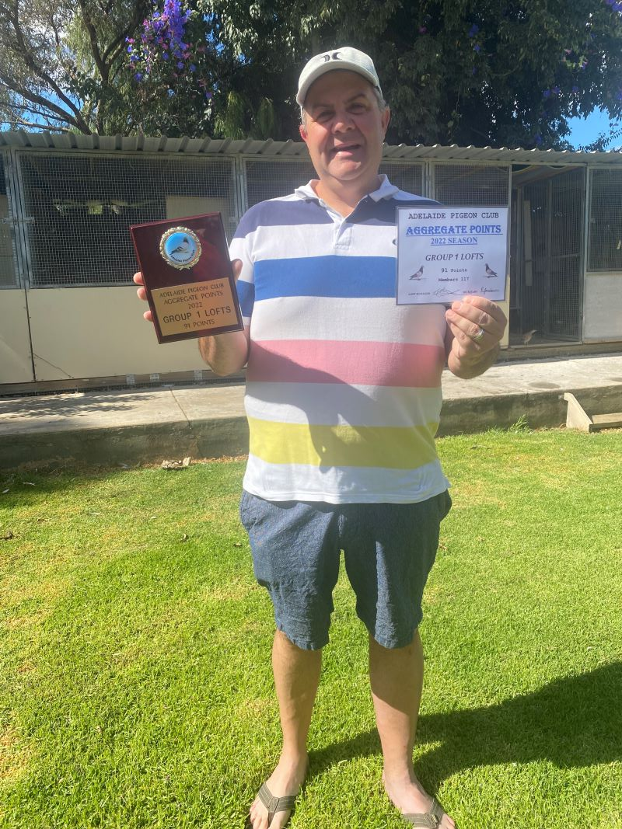
TOP PERFORMANCES 2025 SEASON
1st SAHPA SDC Carrieton No 1 250 km 1482 b 2025
1st SAHPA SDC Hawker No 2 303 km 2915 b 2025
1st SAHPA SDC Carrieton No 3 250 km 2287 b 2025
1st SAHPA Marree Sires Produce 546 km 194 b 2025
40 top 30 SAHPA Open positions, including 7 x top 30 places from Alice Springs, 7 x top 30 places from Coober Pedy & 5 x top 30 SAHPA Places from Marla in 2025.
1st Meadow OLR Race No 2 2025
7th SAHPA Overall Points Score 2025
7th SAHPA Long Distance Points 2025
8th SAHPA Short Distance Points 2025

Slide 5
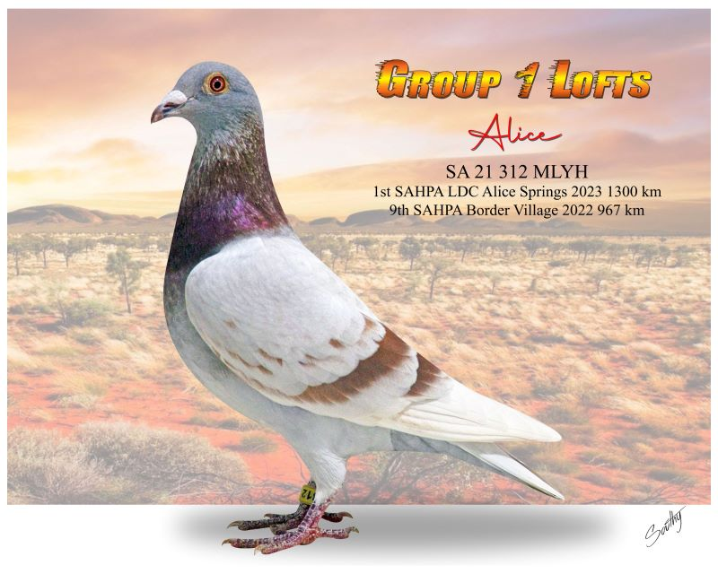
Our Bloodlines include the following premium lines: European lines via Leo Heremans, Eijerkamp Family, Koopman, Gaby Vandenabeele and from retired ace SAHPA fancier Greg Hamilton. The Group 1 Distance lines based on The Allen Goodger/John Pryor & Greg Hamilton families all names synonymous with success in the strong SAHPA competition, we have developed this family over many years and were SAHPA Long Distance champions in 2023. Our birds are currently winning many races for us and others across Australia.
Picture of Alice our champion Long Distance Racer, Alice achieved a dream of a lifetime for us when she won the most famous Long- Distance race in Australia the Alice Springs Marathon! Alice is now proving to be a super breeder of Long Distance birds for us with two daughters already placing top 10 in Alice Springs and Marla in 2025.

Slide 6
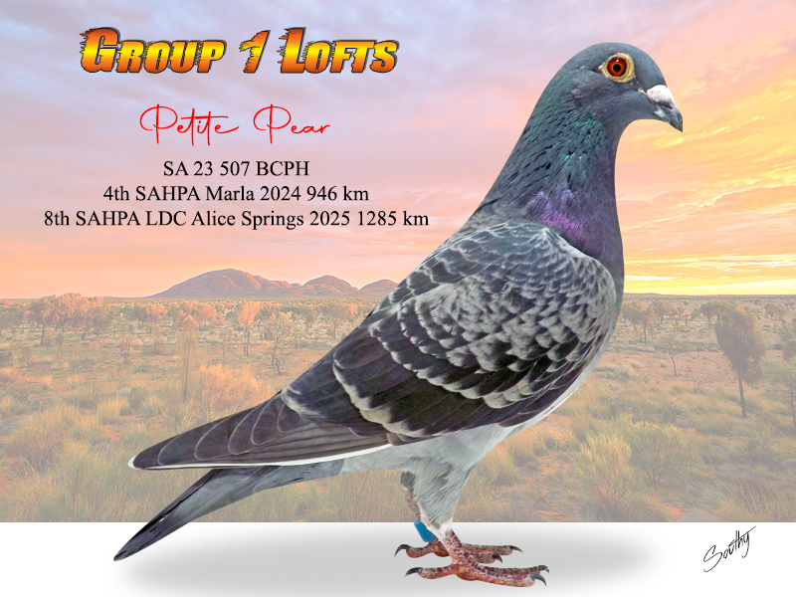
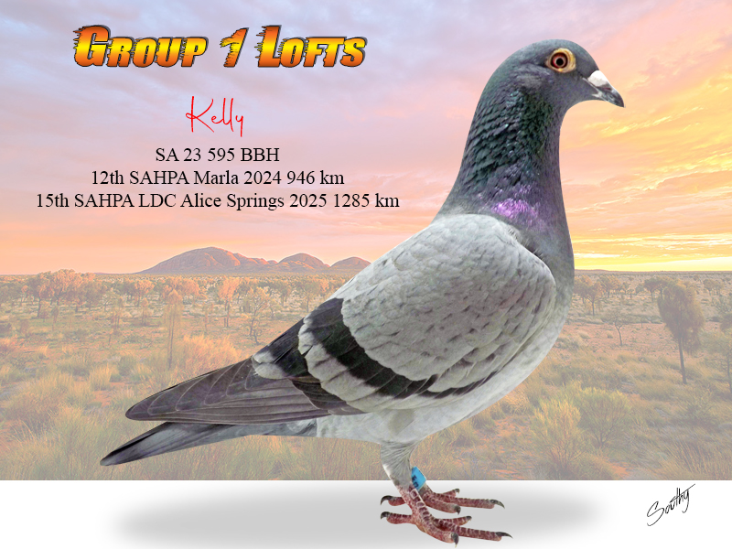
Group 1 Long Distance Family-Top Performers

Slide 7
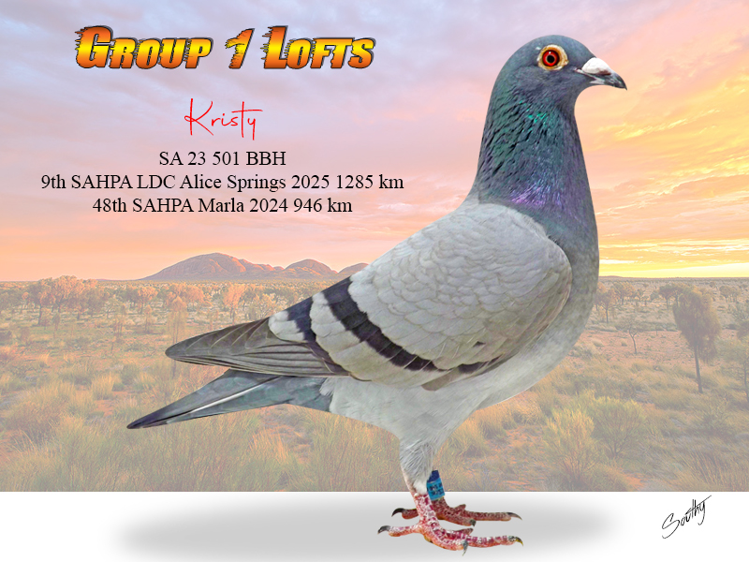
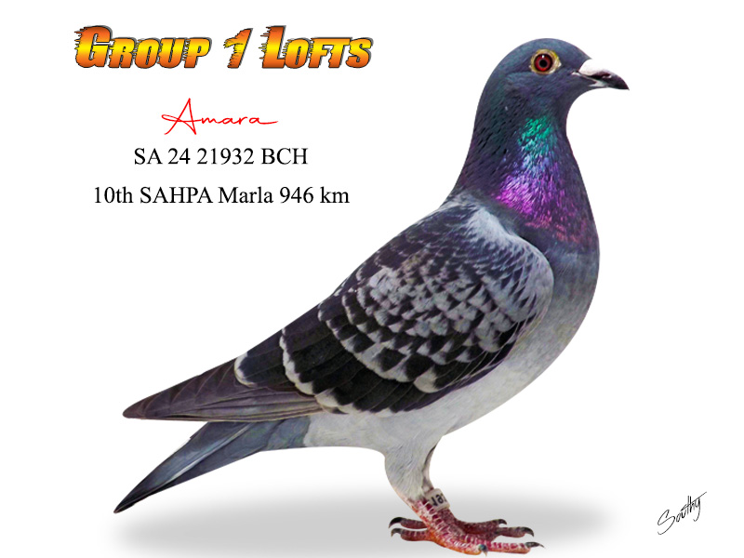
Group 1 Long Distance Family-Top Performers Full Sisters Kristy & Amara-both daughters of Hercules and Alice both top 10 placed in 2025 at long distance.

Slide 8
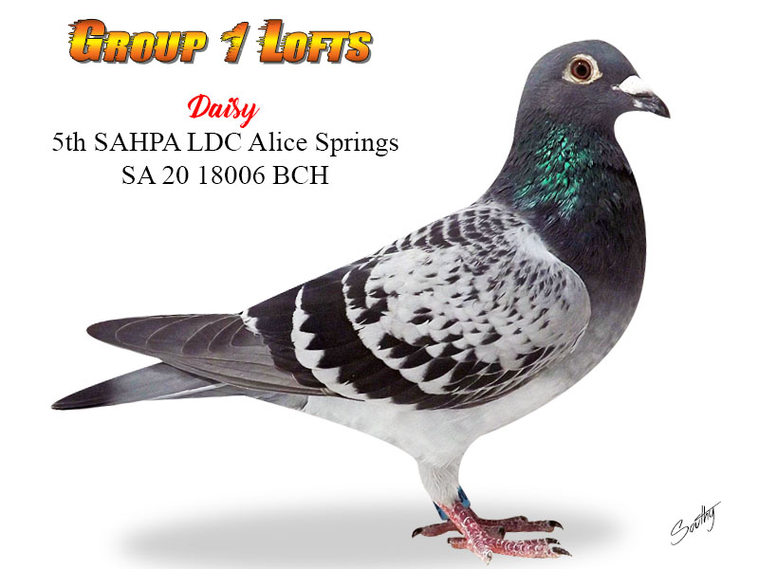
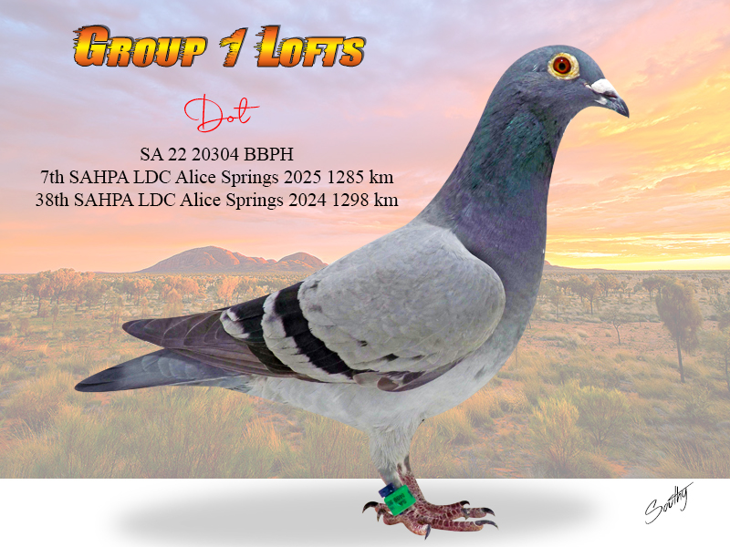
Group 1 Long Distance Family-Top Performers

Slide 9
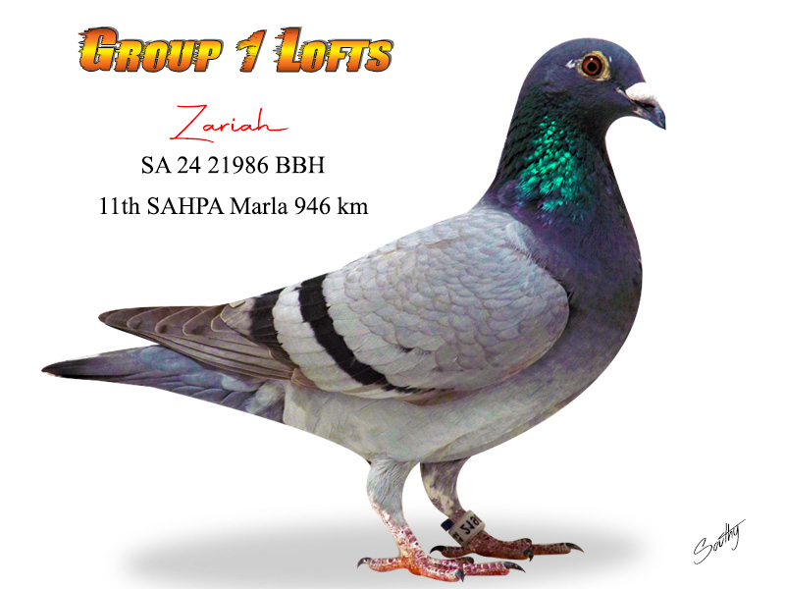
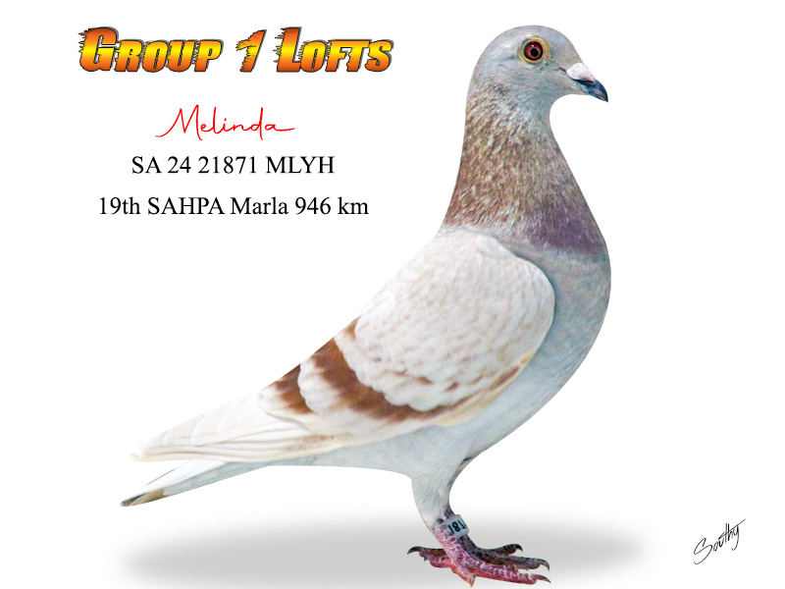
Group 1 Long Distance Family-Top Performers Two young aces Zariah (sister to ace hen Kelly) and Melinda (sister to Alice and Alicia) have now entered the stock lofts following our house move this year we will be racing their offspring this year.

Slide 10
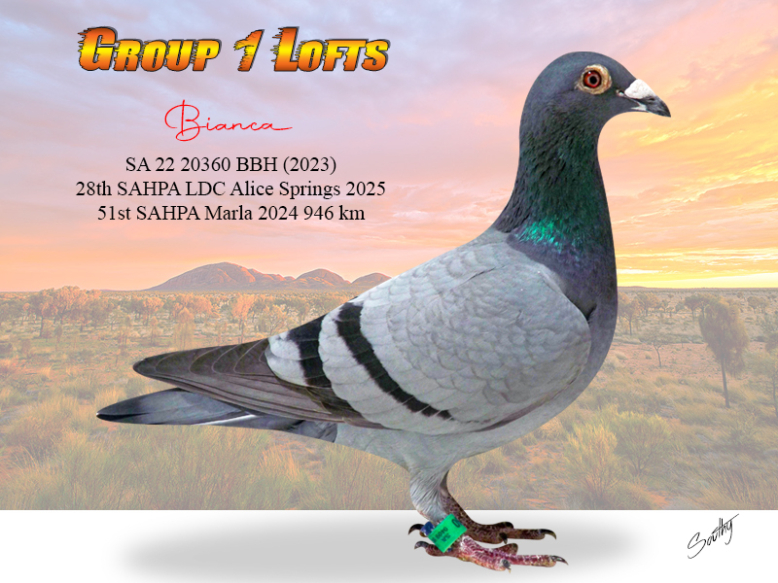
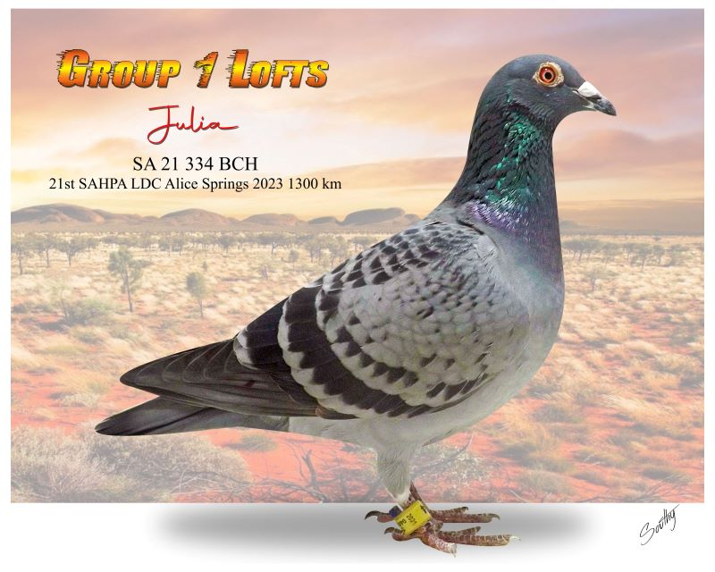
Group 1 Long Distance Family-Top Performers Julia and her daughter Bianca both top performers for us in the last few years flying out the season twice and placing in hard long distance events.

Slide 11
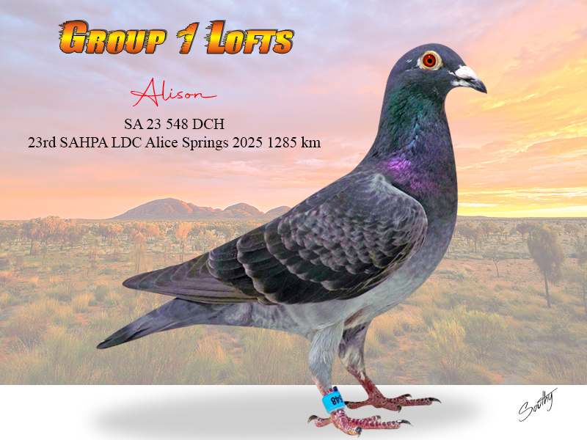
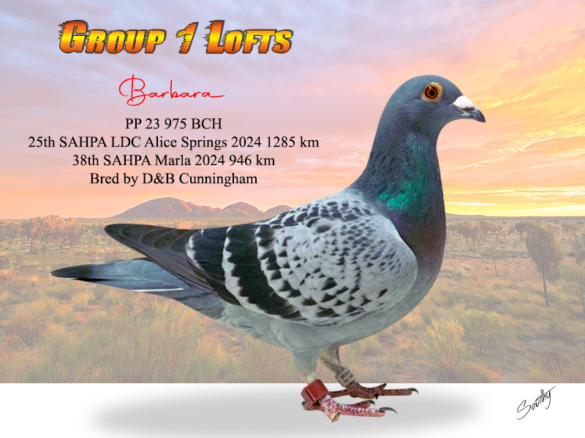
Group 1 Long Distance Family-Top Performers

Slide 12
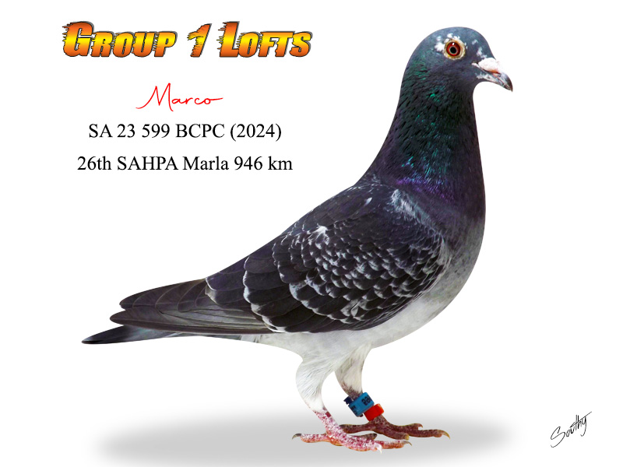
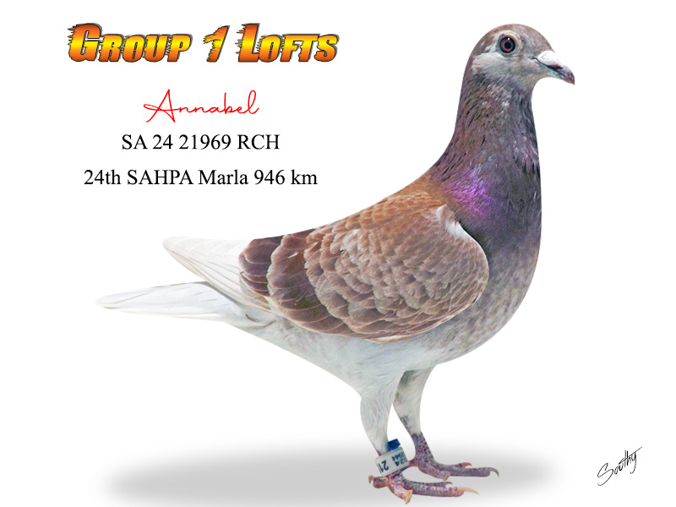
Group 1 Long Distance Family-Top Performers

Slide 13
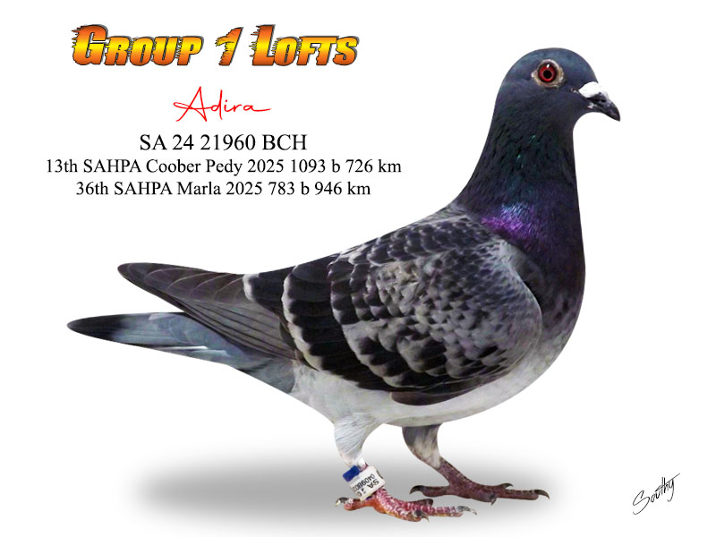
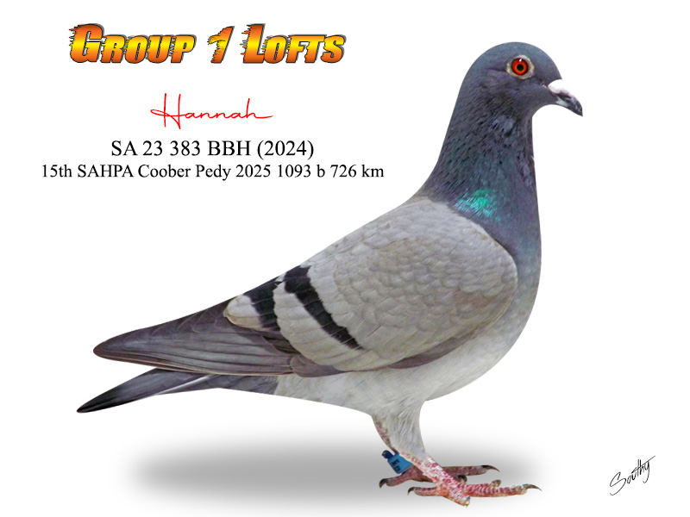
Group 1 Long Distance Family-Top Performers Both of these top young hens flew the Marla 946 km event and then 3 weeks later backed it up with an 11 hr fly from Coober Pedy both homing on the night to place in the top 15 prizes, both hens are closely related to Alice-1st Alice Springs 2023.

Slide 14
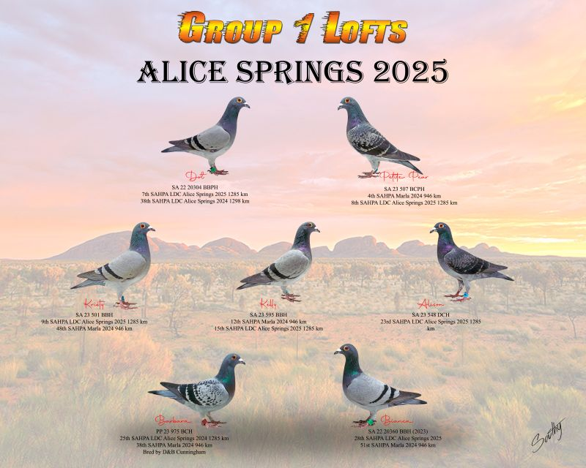
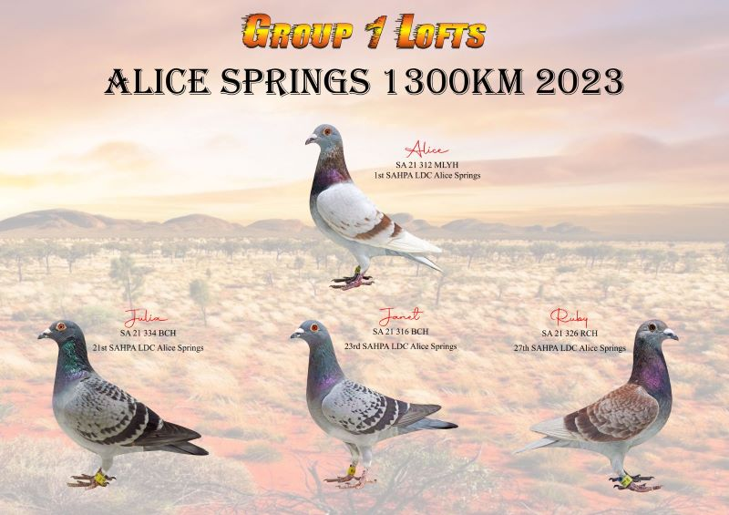
Group 1 Long Distance Family-Top Performers

Slide 15
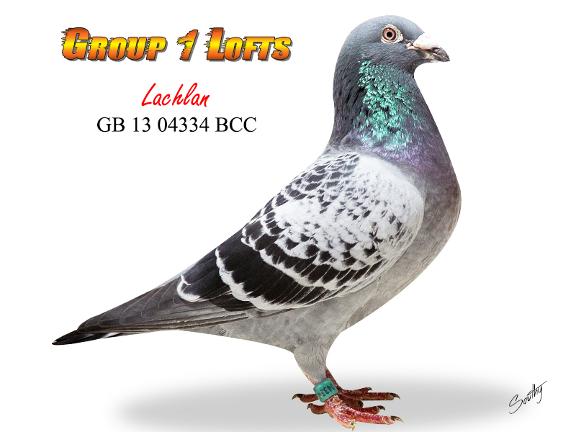
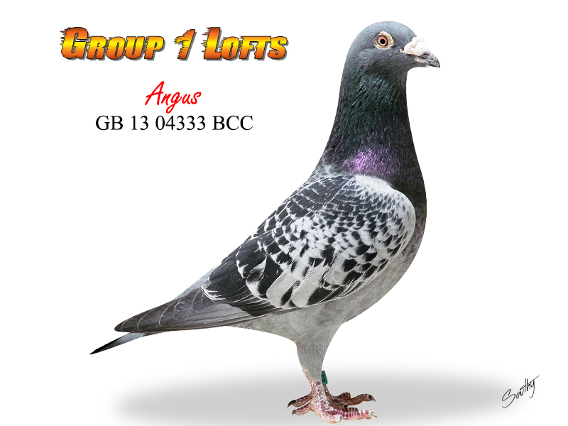
Group 1Euro Family-Top Performers In 2014 we made our first importation of birds and focused on the Leo Heremans family. In our first couple of shipments we purchased two nest mate brothers Angus & Lachlan both grandsons of the famous Nieuwe Olympiade (purchased by the Eijerkamp family), We also purchased Harry & Sally from the Eijerkamp family both children of “Jackpot Junior” & “Canberra Rossi” Rossi x Kadootje, we added in Erin from Premier UK studs from the Dark Destroyer Heremans lines to add to our direct children from the famous Olympus (son of the Olympiade 003). All of these birds form the nucleus of our top winning Heremans family today.

Slide 16
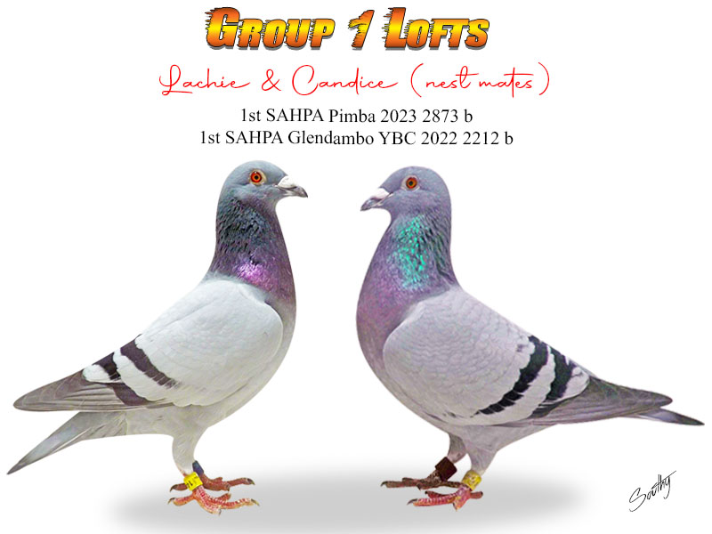
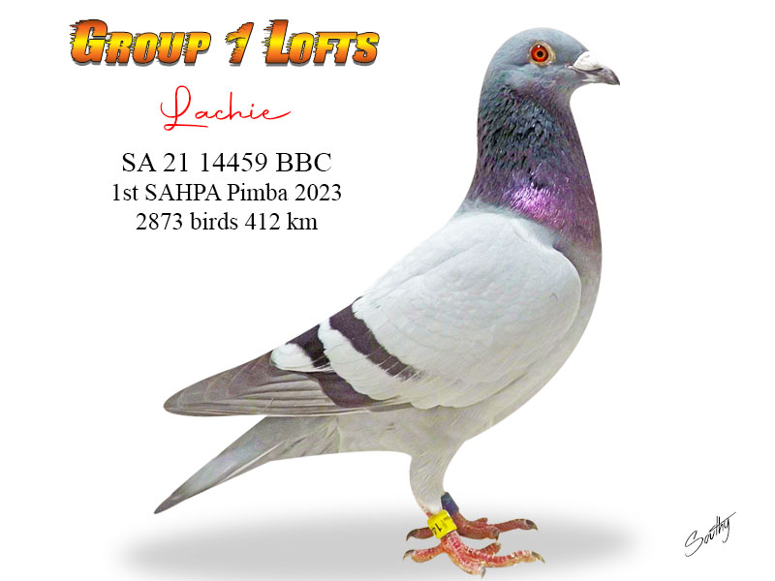
Group 1Euro Family-Top Children Lachlan Direct children from our No 1 pair Lachlan & Bonnie parents of 3 x 1st SAHPA winning birds. Lachie in his first breeding season bred 2 x 1st SAHPA with sisters Eve & Millie

Slide 17
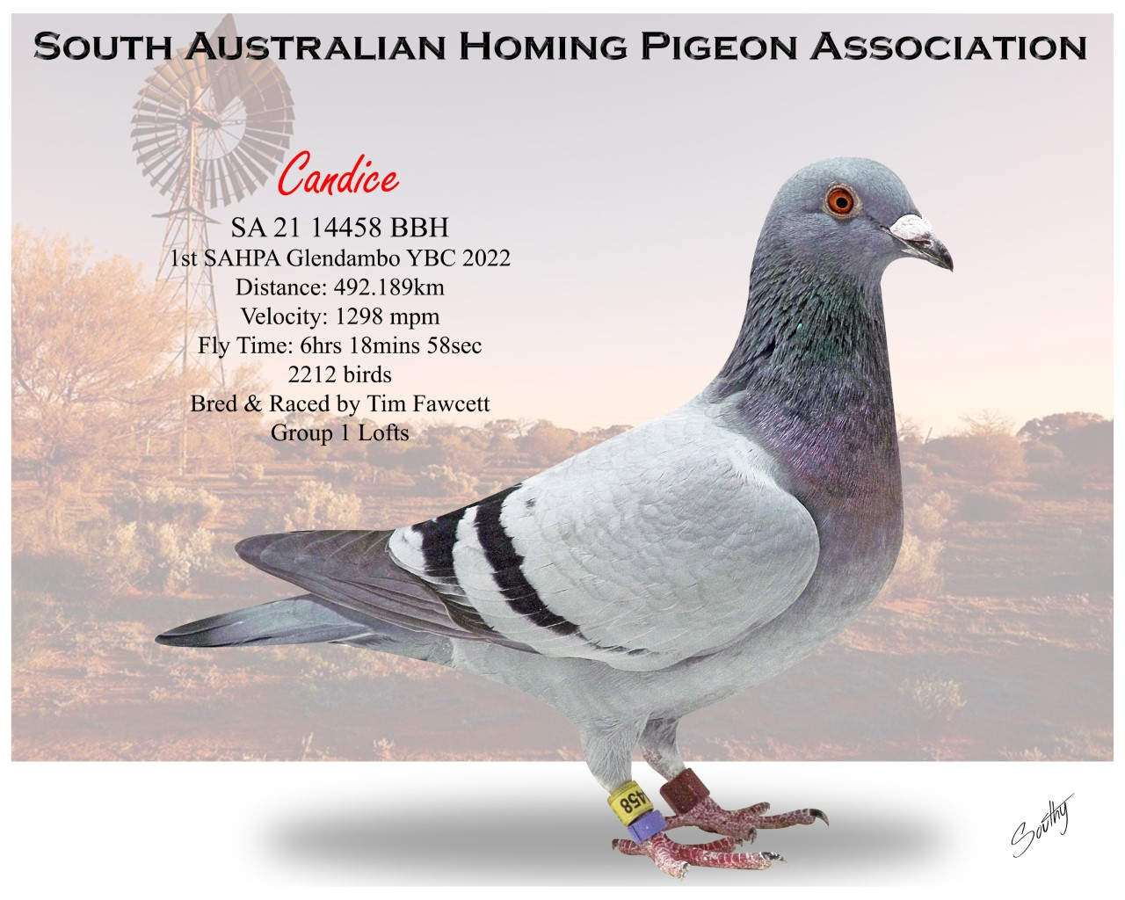
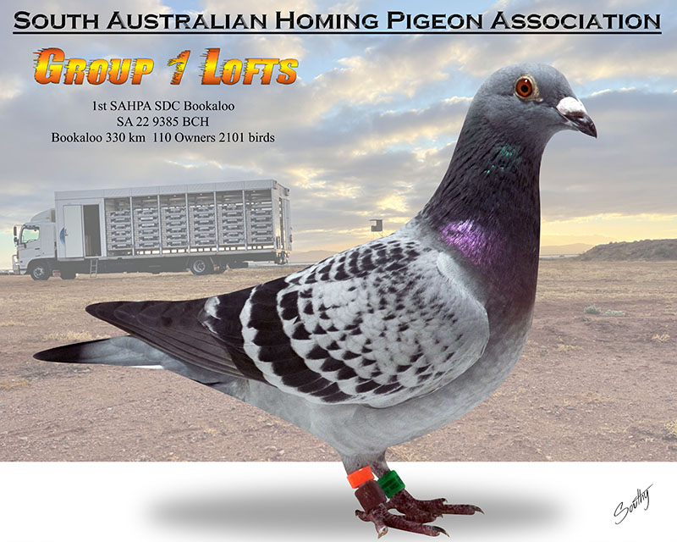
Group 1Euro Family-Top Children Lachlan Sisters Candice & Aphrodite both SAHPA winning daughters of Lachlan & Bonnie

Slide 18
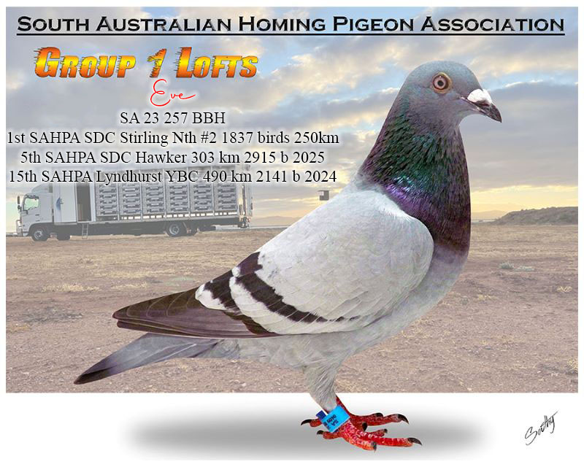
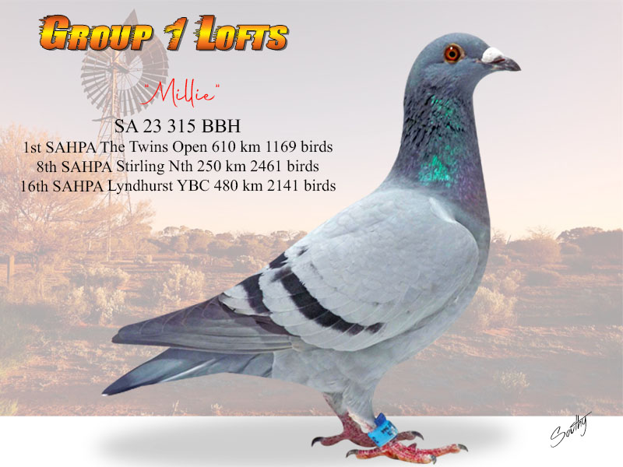
Group 1Euro Family-Top G/Children Lachlan Full sisters Eve & Millie both outright champions, Eve has 4 x SAHPA places 1st, 5th twice and 15th SAHPA, Millie raced 3 times for 3 SAHPA places including the clear win from the Twins Open 610 km. Daughters of Lachie (Lachlan x Bonnie) & Bloom (Robert-son Olympus x Chrystal-dtr Erin)

Slide 19
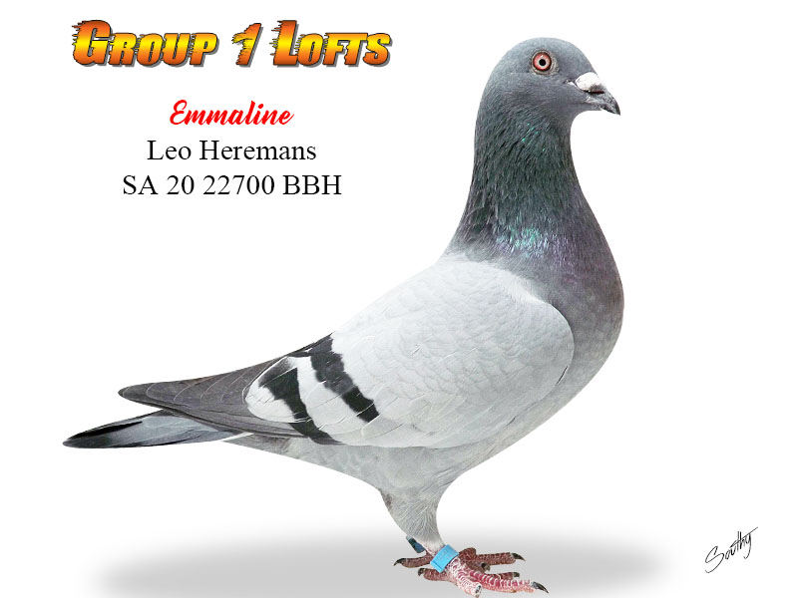
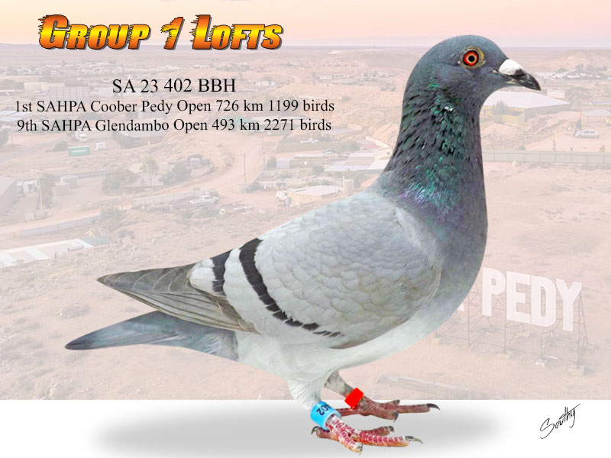
Group 1Euro Family-Top G/Children Lachlan Emmaline was bred from a special pairing Lachlan to his niece champion racer Emma. Emmaline has bred several top birds at this stage, her best being Melanie 402 BBH who was Equal 1st SAHPA Coober Pedy landing with 7 loftmates to win her 2nd top 10 placing for that season.

Slide 20
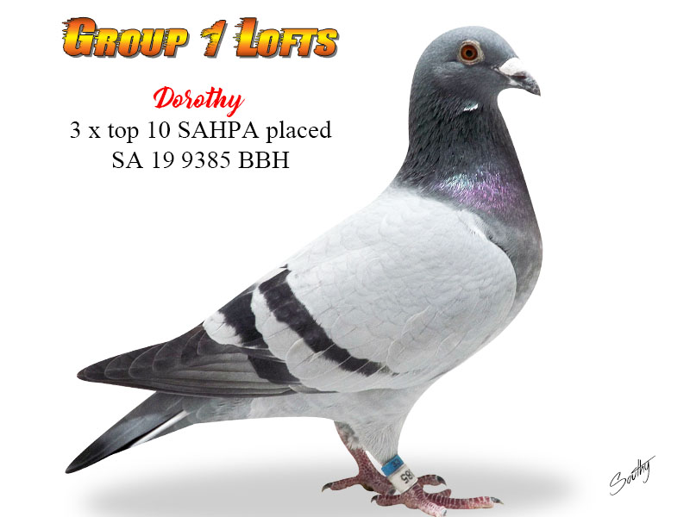
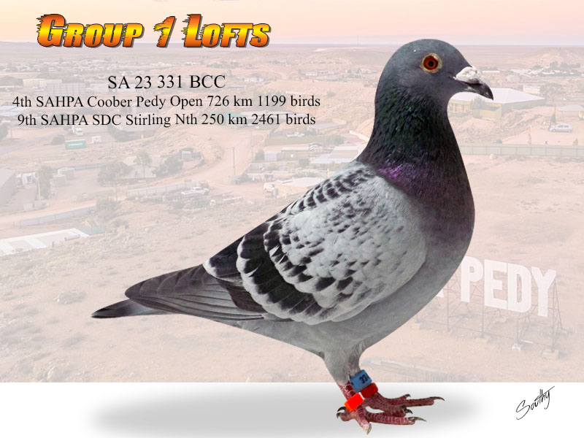
Group 1Euro Family-Top Children &G/Children Lachlan The apple doesn’t fall far from the tree! Ace racer Dorothy who placed 2nd, 3rd & 8th SAHPA in 2 years racing and is from super pair Lachlan x Bonnie. Her best son to date is “Drew” this super race cock was one of 7 loftmates to land together from Coober Pedy 726 km in 2024 for us which took out the SAHPA most outstanding performance and an achievement that no one before us has done from that distance. Drew’s sire is Super Slate from the famous Eijerkamp lines of Olympic Leo & Luka Modric.

Slide 21
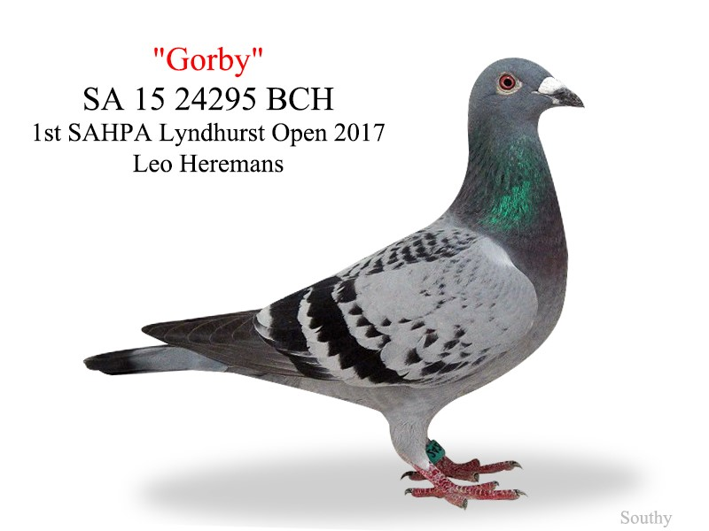
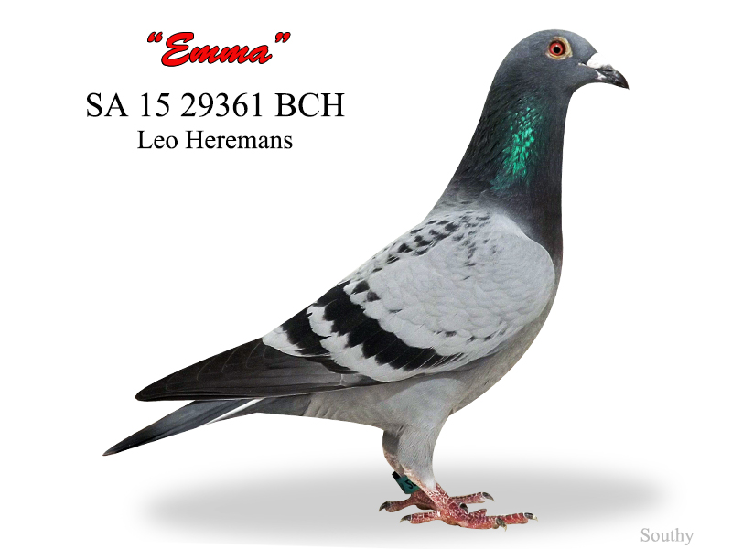
Group 1Euro Family-Top Children Angus Gorby won the Lyndhurst Open event in 2017 by 1 second and Emma was placed 2nd, 3rd & 7th in SAHPA races, ironically she lost by 1 second. Emma’s g/dtr was Equal 1st SAHPA Coober Pedy 726 km in 2024.

Slide 22
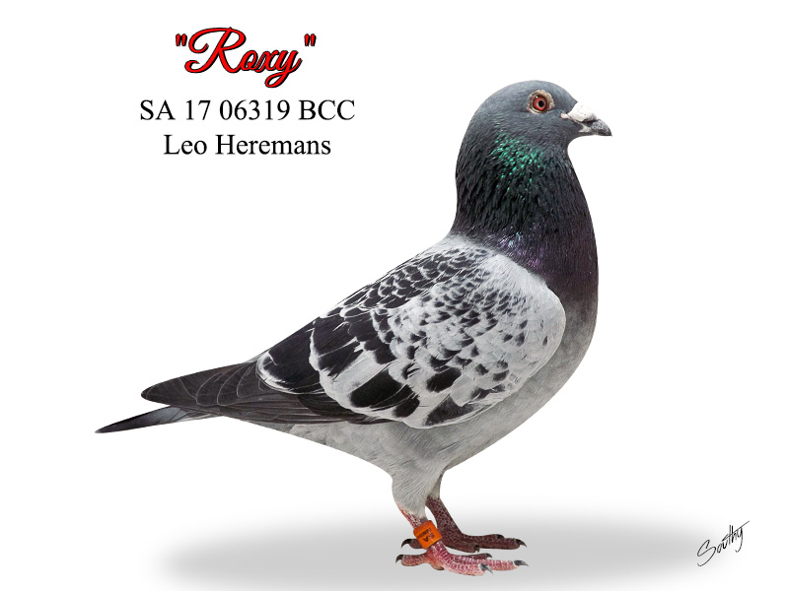
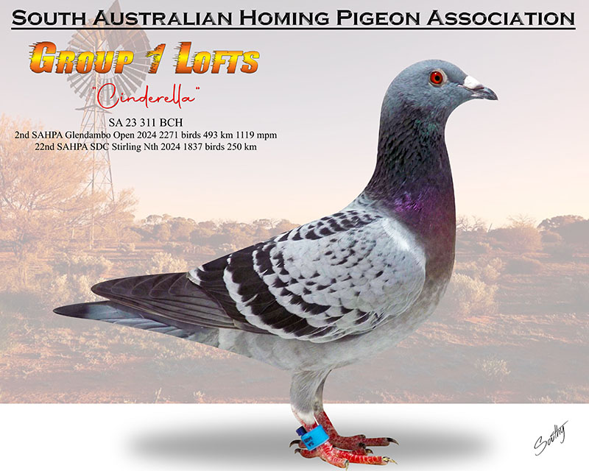
Group 1Euro Family-Top Children & G/Children Angus Roxy has been a super breeding son of Angus x Sally (original Eijerkamp dtr Jackpot Junior & Canberra Rossi). Upon the passing of Lachlan, the decision to mate Roxy with super hen Bonnie was formed it has been nothing short of sensational to date in the first season Cinderella 3 x SAHPA placed 2nd (landing with 3 loftmates to win), 4th & 22nd, Tristan was 6th Bundaberg OLR in 2024 then bred Opal 2nd SAHPA Coober Pedy in 2025 & Melanie II 8th SAHPA Marree Sires Produce in 2025 what a start for this new pairing.

Slide 23
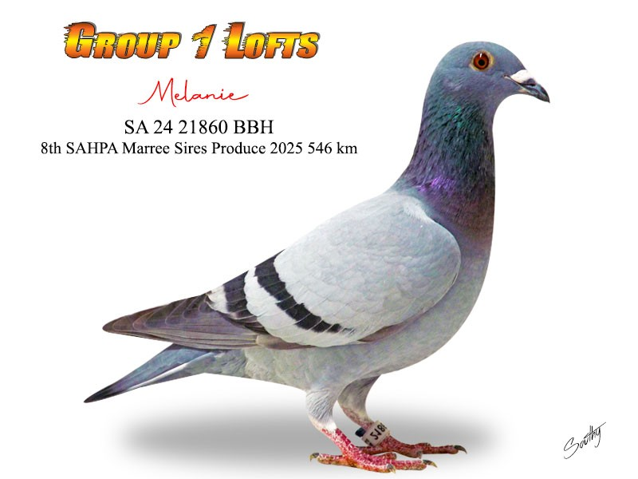
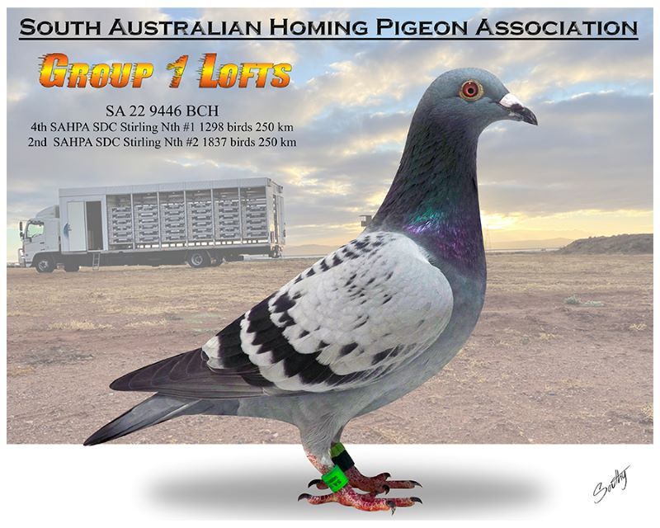
Group 1Euro Family-Top Children & G/Children Angus Two top g/dtrs of Angus Melanie II and 9446 BCH who was a top racer, unfortunately taken by a falcon as a 2 year old in training.

Slide 24
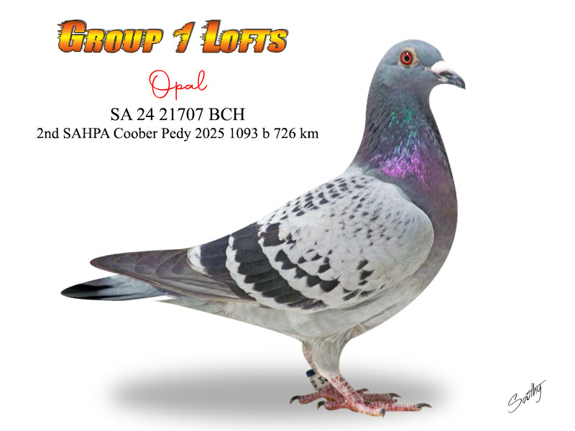
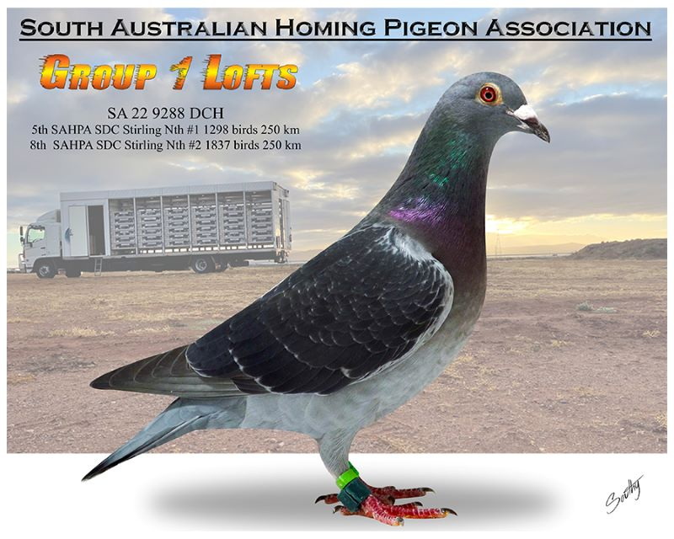
Group 1Euro Family-Top G/Children Angus The next generation keeps winning with Tristan son of Roxy x Bonnie who was 6th Bundaberg OLR final in 2024, then in his first season is sire of Opal who was 2nd SAHPA Coober Pedy 2025 726 km in a tough 11 plus hr fly. The cream rises to the top! Ivy 9288 DCH is also a g/dtr of Angus placing 5 x in the SAHPA, 4 x in the top 10 making her one of the best hens to ever race in the strong SAHPA competition, she also bred 4th SAHPA with her one and only youngster in 2025.

Slide 25
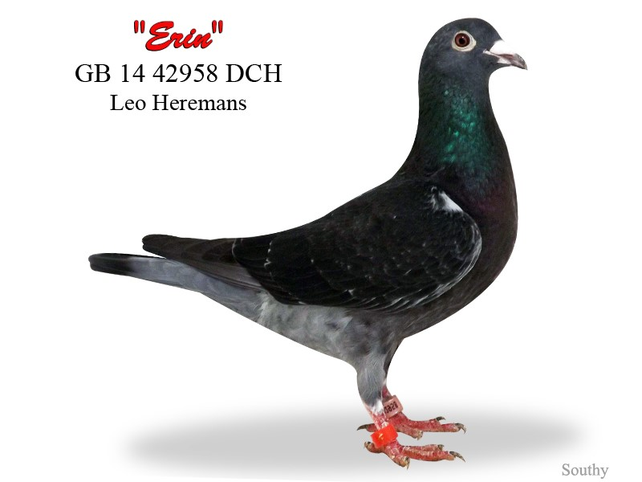
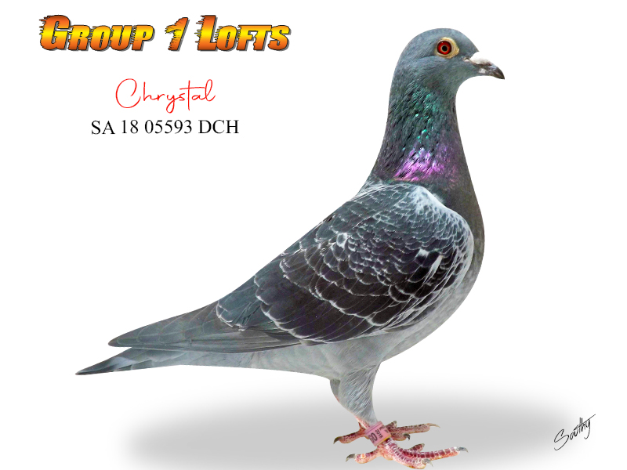
Group 1Euro Family-The Erin Dynasty Erin was imported by us from Premier UK Stud in 2015 as a late replacement for another bird. Her influence on our loft has been nothing short of sensational, moving her lines through the Angus, Lachlan, Master Luke & John (both Olympus lines) her progeny directly and down again. Her best producing daughter Chrystal bred 9th Pattaya International OLR Ace Bird against 12178 birds in 2026. Her grandchildren and great-grandchildren win consistently in the SAHPA and other Feds across Australia. She is by far the best hen we have ever brought into our lofts her influence is next level.

Slide 26
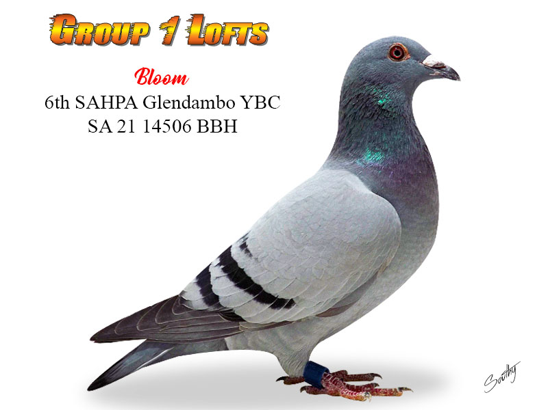
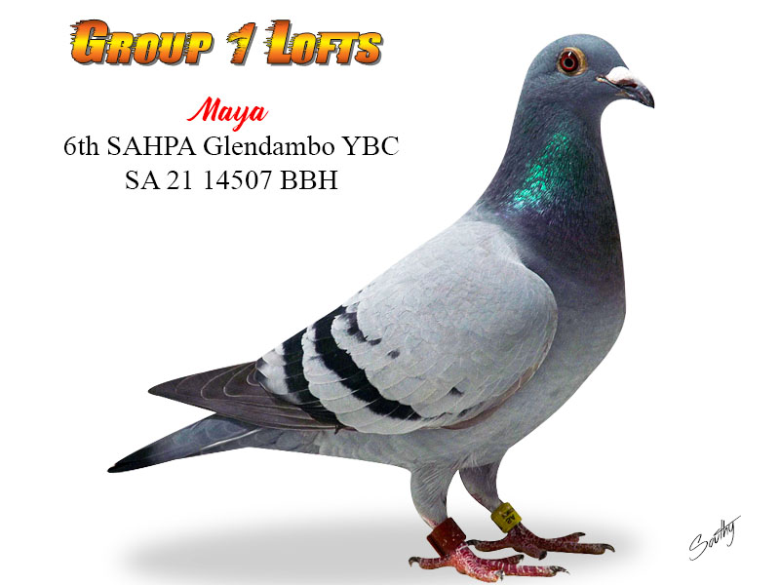
Group 1Euro Family-The Erin Dynasty Bloom and Maya were both top racers for us and now top producers, bred from Robert (Olympus x Gracie)and Chrystal (John x Erin) these two g/dtrs of Erin have both been sensational since entering the stock lofts. Bloom produced 2 x 1st SAHPA winners (Eve & Millie) in her first breeding season and Maya bred “Mister Squiggel” 3rd SAHPA in 2025 for us

Slide 27
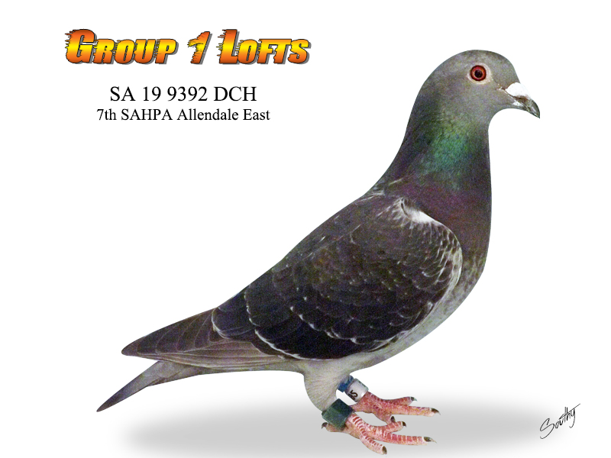
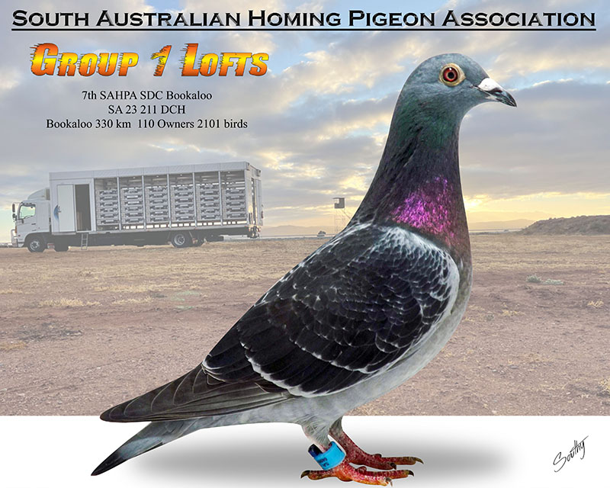
Group 1Euro Family-The Erin Dynasty Georgia 9392 DCH is a top g/dtr of Erin, she was a top race hen placing 7th SAHPA, she entered the stock lofts in 2021 after two seasons of top racing and has immediately left her mark with multiple top 10 SAHPA placed birds, and in 2025 she bred 1st CCF Booligal 563 km for our friends the Pedavoli Bros in Sydney, this line keeps breeding down and down again with her daughter 211 a top racer twice SAHPA placed and dam of top placing in Pattaya IOLR in 2026 for us.

Slide 28
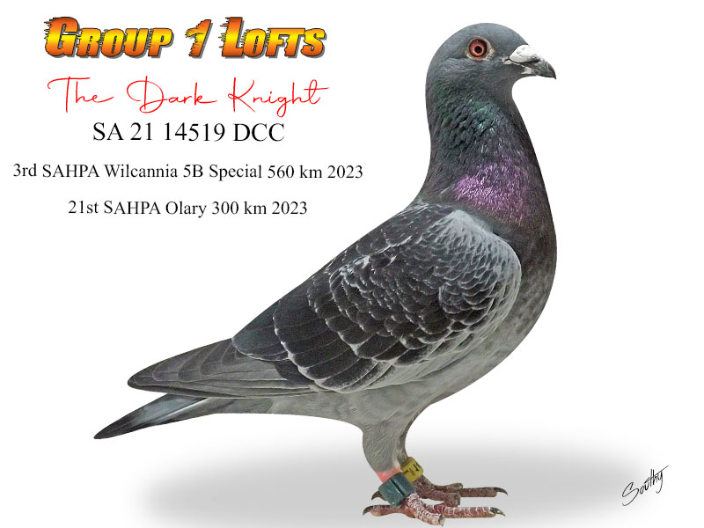
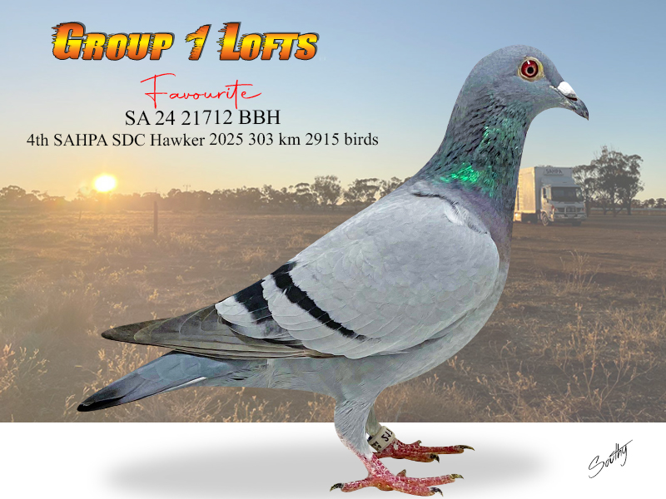
Group 1Euro Family-The Erin Dynasty The Dark Knight was a super racing g/son of Erin, narrowly defeated from Wilcannia, he then was paired with Stella (Angus x Erin) and in their first season bred the 5 x SAHPA placed Ivy 9288 DCH who then in turn bred Favourite in her first next who landed with 5 loft mates to win the SAHPA SDC event from Hawker in 2025.

Slide 29
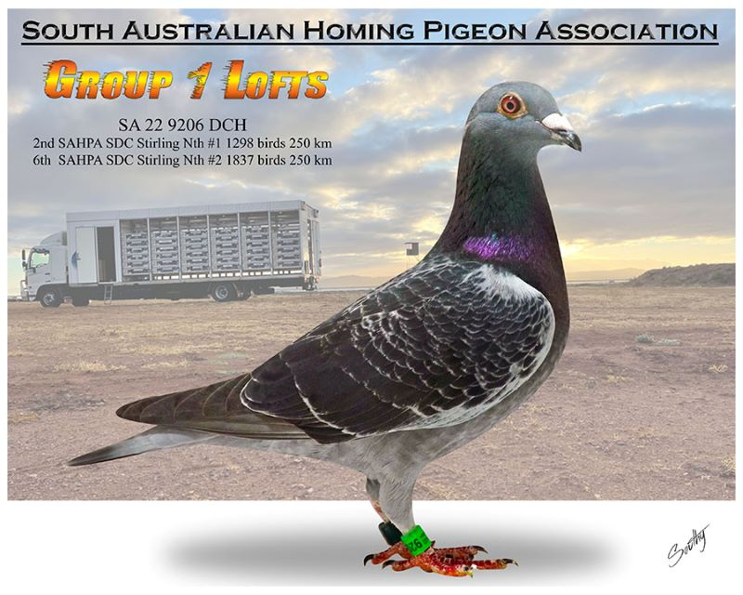
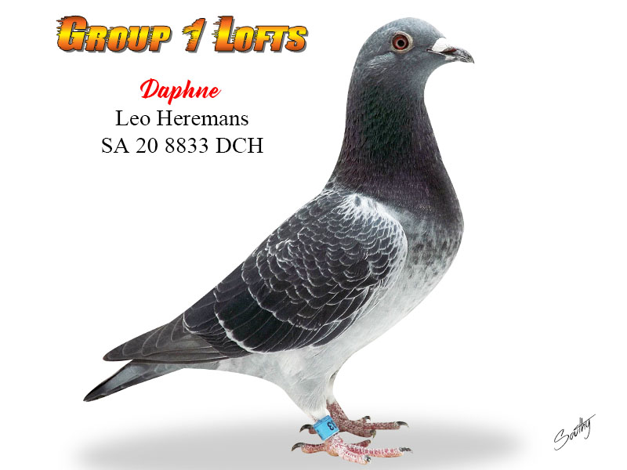
Group 1Euro Family-The Erin Dynasty Daphne (Robert x Erin) is the top producing dam of “The Dark Knight” and Brooke 9206 DCH was 3 x SAHPA placed for us twice in the top 10 landing with loftmates to win the race on both occasions, she will have offspring racing for us in the 2026 season. Brooke is a full sister to ace hen Chrystal (John x Erin)

Slide 30


Group 1Euro Family-The Erin Dynasty Amanda & Brutus were both top racers for us in 2025. Amanda is bred from Lucas (son Master Luke) & Elizabeth (John x Erin). Brutus is bred from He’s Dreamin (Lachlan x Livin Dream) the sire of the Dark Knight & Rebecca top racing daughter of (John x Erin). The performance of Brutus was very special placing out of position on the day in a solid all day fly. Both of these top birds have now entered our breeding lofts.

Slide 31


Group 1Euro Family-The Erin Dynasty Arlo & Glen are our two sons of Erin, Erin was a big percentage breeder of hens during her time. Arlo has already produced 3 x top 5 SAHPA places in his first season used. Glen 9464 DCC we have high expectations for given he is a full brother to Chrystal (John x Erin).

Slide 32


Group 1Euro Family-The Ponderosa Heremans Master Luke & Monique were our original Ponderosa Australia Heremans pair. They came to our lofts in 2012 and their impact was felt immediately. They were the reason we ventured into importing around 12 Leo Heremans family birds in the years following. Master Luke’s son John is one of our ace breeders and the click into the Erin family, we were fortunate enough to then go on and purchase several other direct children from Olympus around 5 yrs ago and those birds have been highly successful also. Full siblings Robert, Rusty Nailz and Belinda are all ace breeders in our loft. Rusty Nailz being the sire of 9th Ace Pigeon in the Pattaya International OLR in 2026 against 12178 birds.

Slide 33


Group 1Euro Family-The Ponderosa Heremans John and Lucas are both top producing sons of Master Luke. John (Master Luke & Verdi) was the traditional mate to Erin and we have numerous top producing and racing children from this mating. Lucas (Master Luke x Monique)is also leaving his mark and is now being mated back into the Erin lines with great success his daughter Amanda flew a difficult tough two day Coober Pedy in 2025 placing 11th in this tough event.

Slide 34


Group 1Euro Family-The Ponderosa Heremans Robert & Rusty Nailz are full brothers bred from the champion Olympus (one of only two direct sons of the famous Olympiade 003 ever imported into Australia). Robert through his top racing daughters Bloom & Maya is the g/sire of 2 x 1st SAHPA in 2024 for us. Rusty Nailz has sired several top birds for us and others his son Heremans Ace being 9th Ace bird overall in the Pattaya International OLR in 2026 against 12178 birds entered, this bird recently sold on PIPA for 4600 Euro.

Slide 35


Group 1Euro Family-The Ponderosa Heremans Heremans Ace is the 9th Ace bird Pattaya International OLR 2026, a son of Rusty Nailz & Chrystal. Belinda is the top producing full sister to Rusty Nailz & Robert and has bred us multiple top 5 SAHPA placed birds, most recently her two sons with ace Eijerkamp cock Blue Leo placed 3rd & 4th in the SAHPA when we dropped 4 to win the event in 2025.

Slide 36


Group 1Euro Family-The Eijerkamp Family The Eijerkamp family birds for us have been sensational since our first importation back in 2014, initially we brought in the Heremans lines around Jackpot Junior & Euro. We assisted a friend to import some top children of Olympic Leo, Luka Modric, Olympic Hans and New Che in 2020 with a view of purchasing children, both Super Slate & Blue Leo are children of the ace son of Olympic Leo both have bred SAHPA winners for us in 2024 and 2025. A g/dtr of Blue Leo also won the famous SAHPA sires produce event in 2025 for us.

Slide 37


Group 1Euro Family-The Eijerkamp Family Lotsa Leo won the SAHPA SDC event in 2025 from Carrieton against 2287 b, he is a son of Super Slate & DeHavilland also another g/dtr of Olympic Leo. Lady is the daughter of Blue Leo & Duchess who two weeks straight was the winner or landed with the winner in SAHPA events. Duchess also produced 10th Meadow OLR final in 2024, this hen Helen then produced Opal 2nd SAHPA Coober Pedy for us in 2025. A full brother to Lady also bred 1st SAHPA Marree Sires Produce 553 km for us in 2025.

Slide 38


Group 1Euro Family-The Eijerkamp Family Princess was 1st SAHPA Marree Sires Produce bred from a son of Blue Leo with her dam containing all the top Eijerkamp lines of Olympic Hans, New Che, Olympic Leo & Luka Modric. De Javu has retired as a champion racer with back to back 3rd SAHPA Coober Pedy in consecutive seasons, she is bred from De Havilland a granddaughter of Olympic Leo & Lynn.

Slide 39


Group 1Euro Family-The Eijerkamp Family Blue Special is also a top breeder for us having bred 3 x top 10 SAHPA places in her first years of breeding she is a g/dtr of Olympic Hans & New Che. Her daughter Sheridan narrowly defeated in the 2022 running of Coober Pedy 726 km losing by 3 seconds when landing with 3 loft mates.

Slide 40


Group 1Euro Family-The Eijerkamp Family Morley & Blade were two of our top stars in 2025 both full brothers bred from ace breeder Blue Leo & Belinda (dtr of Olympus & Gracie) both of these boys flew 7 races each and were ultra consistent in their first race landing with two loft mates to take the first four prizes in the SAHPA from Carrieton. Both were retired to the stock loft at the end of the season.

Slide 41


Group 1Euro Family-The Greg Hamilton lines We have been very fortunate to have a long term great friendship with ace now retired fancier Greg Hamilton, the highlight was getting to race in partnership with Greg for two full seasons just as he retired from the sport. The mentorship and knowledge Greg passed onto us with all aspects of pigeon racing and management has been instrumental in our current success. Greg’s family is made up of top imported lines that he directly imported they are a combination of Gerard Koopman, with many birds directly imported from the ace, Eijerkamp family also top Heremans lines imported from their best, Gaby Vandenabeele lines and also top Van Loon lines down from the Eijerkamp family. Greg blended all of these lines to create a hybrid super winning family and many of these birds have been superstars for us. We purchased Greg’s best hen “Duchess” when he retired and she has been an exceptional breeder for us down and down again.

Slide 42


Group 1Euro Family-The Greg Hamilton lines Super Siblings Bella (SAHPA Bird of the Year 2024, SAHPA Ace Bird of the Year 2024 Young Birds, 1st & 3rd SAHPA), Her brother Rodger was placed 7th SAHPA The Twins & 9th SAHPA SDC Stirling Nth 2024 and another sister Therese 338 BCH placed 3rd SAHPA SDC Hawker in 2025 landing with 5 loft mates to take the first 5 places. They are grandchildren of Tick Tock 1st SAHPA Allendale and daughter of Duchess.

Slide 43


Group 1Euro Family-The Greg Hamilton lines The Hamilton family have a knack of breeding multiple placed birds, we have had 2 x champion SAHPA Birds of the year in the past 5 yrs from this family. Violet was our champion bird when we raced with Greg in 2020 and was 3rd & 5th SAHPA Allendale and also won the prestigious Vin Blanden Memorial race in 2020. Her champion granddaughter Champagne Supernova was a top racer for us in 2024 & 2025 she landed with 7 loftmates in 2024 to place in the Coober Pedy event when we took the first 7 prizes and was 1st SAHPA SDC Hawker in 2025 landing with 5 loftmates, a real front runner, she retired after her last race and 4th SAHPA top 30 placing from Coober Pedy in 2025 and has bred some outstanding youngsters.

Slide 44


Group 1Euro Family-The Greg Hamilton lines Mae was one of our ace performers of 2025, she was 1st SAHPA SDC Carrieton, 2nd SAHPA SDC Hawker & 2nd SAHPA Lyndhurst 5 Bird Special she also placed 22nd SAHPA as a young bird. Mae is bred from Sherpa & Brenna, and contains all of Greg’s top lines. Sherpa is a grandson of the famous “Good As Gold” and Brenna a granddaughter of ace Gerard Koopman cock Radison (son of Mighty Man & Daydream)

Slide 45


Group 1Euro Family-The Greg Hamilton lines Amadeus and Mozart are nest brothers both have been top breeders for us, they are full brothers to Brenna (dam of Mae). Amadeus daughter Lilith placed in 2025 from Coober Pedy and he has previously sired 1st Gold Coast 50000 OLR Race 1 winner for us. Mozart has produced multiple top 10 SAHPA places also. They contain all of Greg’s top lines.

Slide 46


Group 1Euro Family-The Greg Hamilton lines Silk was a top racer placing 3 times in the SAHPA for us over 2 seasons, she landed with SAHPA winning loft mates twice, she is predominantly the Koopman lines imported by Greg that were super successful for Greg and others in particular Rolf Goodacre winning 6 top One loft races in Australia with these lines. Rose was a top racer who placed 7th Coober Pedy in 2024 when we landed the 7 birds together, she is a daughter of Violet & Bruce (son Lachlan).

Slide 47


Group 1Euro Family-The Greg Hamilton lines Lucy was runner up in the SAHPA Bird of the Year to Bella in 2024 a super hen who unfortunately we lost in a very tough race in 2025, two of her children flew the entire Pattaya OLR in 2026, she is a daughter of Kate the top daughter of Super Slate & Glory Days SAHPA winning hen for Greg who was also dam, g/dam and g/g dam of SAHPA winners. Glory Days is the daughter of two of Greg’s aces Super 33 & Ermerdream.

Slide 48


Group 1Euro Family-The Greg Hamilton lines Olivia was a top racing daughter of Cloud 904 & Peaches she placed 2nd SAHPA Carrieton SDC in 2025 landing with 4 loftmates that won the SAHPA. Peaches has bred several top birds and is also a daughter of Super Slate & Glory Days.

Slide 49


Group 1Euro Family-The Greg Hamilton lines Cooper was an outstanding racer and now an exceptional breeder, he won the Coober Pedy Cock Bird special in 2021 in Greg’s and our last season together. He is bred from Randy a super cock bird from Greg’s Koopman and Heremans lines when paired with a daughter of Erin. Cooper bred 1st CCF Booligal for the Pedavoli Bros in Sydney in 2025. The Photo is Tim collecting the SAHPA trophy for the most outstanding performance of 2024, landing the first 7 birds in the prestigious Coober Pedy event 726 km with 9.5 hrs on the wing to take the first 7 and have another 5 in the first 30 prizes in the race, it was the 2nd time in 5 yrs our birds have won this award.

Slide 50


Group 1Lofts Award Winning Birds! Tim pictured with son Luke collecting the prestigious Margaret Brown trophy for winning the 2023 SAHPA event from Alice Springs, Tim pictured with then SAHPA Secretary John Harper collecting the 2022 SAHPA most outstanding achievement for placing 5 birds in the top 10 prizes in the Young Bird Championship event from Glendambo 490 km.

Slide 51


Group 1Lofts Award Winning Birds! Tim holding the Adelaide Pigeon Club One Loft Race Champion Fancier award for 2022 winning the overall points score in this one loft club for the season. Picture with champion fanciers and friends in the sport Gerard Koopman & Henk Jurriens (Gen Mgr Eijkeramp)

Slide 52


Proud pigeon moment becoming SAHPA life member in 2024 & with my partner in crime wife Lindsey who is a massive supporter and loves the birds. To contact us call Tim on M: +61400400324, Email: pigeonsalesaustralia@hotmail.com, or follow us on Facebook: Group 1 Lofts-Tim Fawcett

